Slide 1
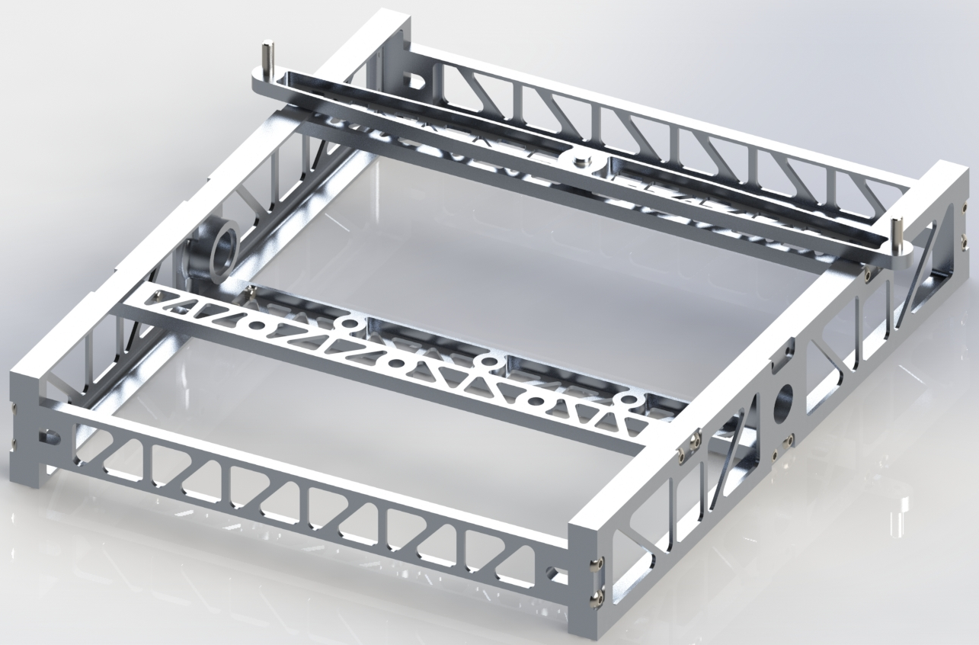

Chassis Upgrades
Tasks
Differential Bar
Chassis panel covers
Battery Clips
Frame Cross members
Camera Platform

Slide 2
Differential Bar
Chassis Upgrades
Toolpaths created in Mastercam
Stock was squared
Squared and prepped stock for CNC
Drilled holes
Toolpaths created in Mastercam
Bottom plate will be created to allow CNC of outer profile
Crossmembers
Camera Mount
Notes:
http://www.franknicol.co.uk/product_images/c/13_0977_61__79287.jpg

Slide 3
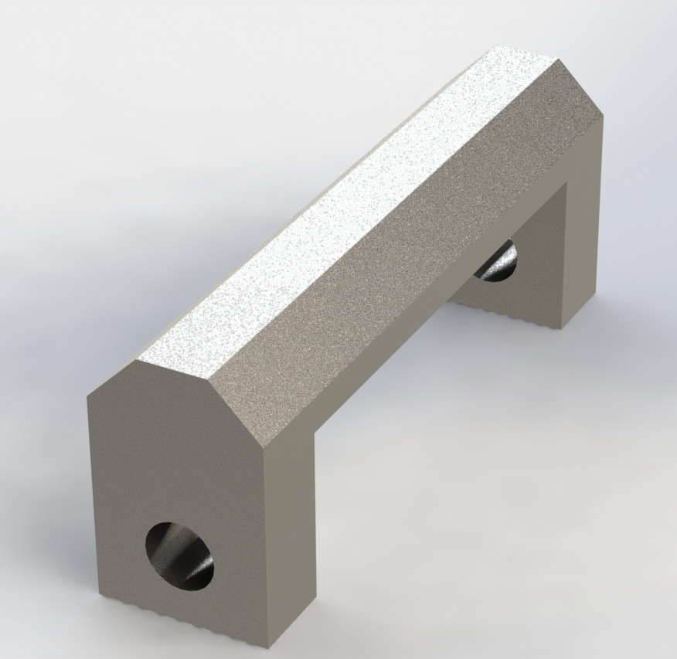
Battery Clips
Chassis Upgrade
Hold battery to bottom cross member
Set screws hold battery clip in place
Must be movable to accommodate extra batteries
Velcro straps will be used to tightly hold battery in place

Slide 4
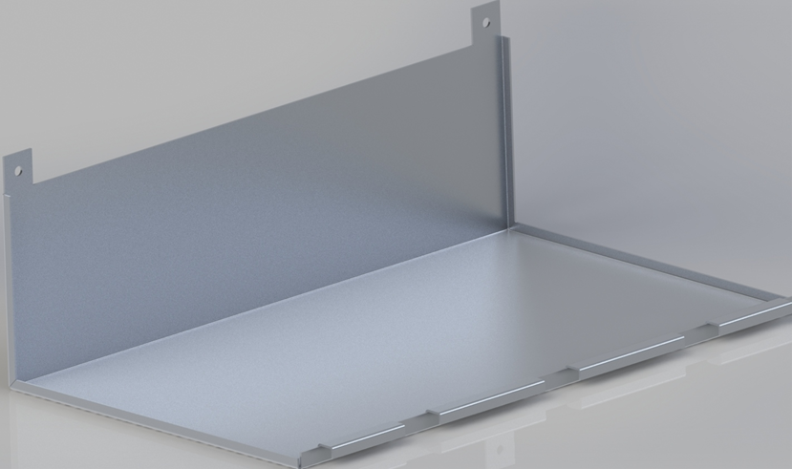
Panel Covers
Chassis Upgrades
Design Considerations
Bottom must solid to hold electronics
Must fit under arm assembly
Easily removable, preferably without removing
Easily Manufacturable

